Slide 1
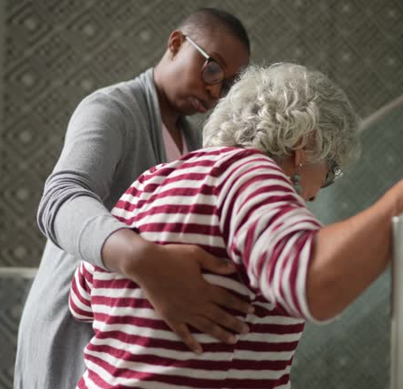
FallGuard Pro
Group 20
Supervised by: Mrs. Vishmi Embuldeniya

Slide 2
Content
01 Problem Statement
02 Research Gap
03 Project AIM
04 SWOT Analysis
05 System Design
06 Implementation
07 Prototype Demonstration
08 Business Model Canvas
09 Testing and Evaluation
10 Limitations and Future Enhancements
11 Conclusion
12 Individual Contributions
13 Q & A

Slide 3
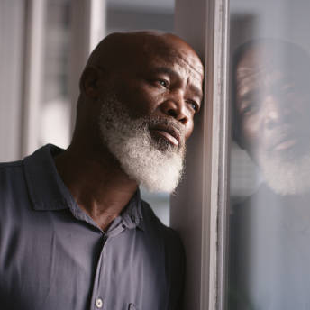
Problem Statement
Many individuals over 70 or with mobility-impairing conditions rely on constant supervision to prevent dangerous falls. However, continuous monitoring isn't always possible, increasing the risk of serious, even life-threatening injuries. Hence, prompting that a better solution be developed for this issue

Slide 4
Research Gap
Lack of a multi-model system
Considering all possible vectors
Imperfect Occlusion Models
Most existing systems that utilize fall detection models and tools normally focus on the utilization of only one model instead of combining the computational intelligence of multiple models to assess if someone is about to fall or in the process of falling. To summarize, given that most systems only consider a single model it tends to lead to issues with making proper prediction, reducing reliability
In terms of considering every possible vector in which a fall may occur, most existing systems simply ensure that at least one possible approach is considered instead of considering multiple approaches. Hence, leading to there being vast miscalculations and incorrect predictions in detecting a fall. So, merging multiple models to assess different approaches is a new approach to this issue
Given that the task of detecting objects that obstruct computer vision models is a challenge since it must always focus on one subject, most subjects tend to vary due to there being different and similar instances to it when detected by the model, hence leading to confusions in what the subject really is. A key factor to reconsider here is to opt for a different approach to detecting a fall instead of solely relying on one approach
(Nguyen, T.-B., Nguyen, D.-L., Nguyen , H.-Q. & Le, T.-L., 2024. A Real-Time and Continuous Fall Detection Based on Skeleton Sequence. [Online] Available at: https://link.springer.com/chapter/10.1007/978-981-97-5504-2_11 [Accessed 15 April 2025])

Slide 5

Choosing the most suitable machine learning models and algorithms to accurately analyze motion data, recognize postures and analyze physiological data for reliable fall detection and prediction
01
Project Aim
To develop a real-time, multimodal fall detection and prediction system for elderly individuals living alone by integrating sensor data (accelerometer & gyroscope), camera-based posture analysis, and vital signs monitoring (heart rate & SpO₂), enabling early detection, accurate classification, and timely alerts through a web-based interface.
Combining models to improve real-world performance using a fusion approach. Integrate multiple data sources to create a fusion model that enhances accuracy and handles real-life variability.
02
Designing a user-friendly web interface for real-time monitoring and alerts. Build a simple, responsive interface to display vital signs, movement data, and send alerts when a fall is detected.
03

Slide 6
SWOT ANALYSIS
Strenghts
Multimodal approach improves accuracy by combining sensor, camera, and vital sign data. Real-time detection and alerting ensures timely response to fall events. Web-based interface allows easy access and monitoring for caregivers or health staff.
Weaknesses
Hardware dependency (sensors, camera, vitals monitor) may limit scalability or increase setup cost. Privacy concerns with using camera data in personal spaces. Real-time processing can be resource-intensive on lower-end systems.
Opportunities
Integration with smart home or wearable devices for commercial deployment. Expansion to broader health monitoring (e.g., early illness detection, elderly activity tracking). Partnership with healthcare providers for real-world testing and adoption.
Threats
Data privacy and security regulations (e.g., GDPR) could limit camera/vitals use. False positives/negatives may reduce trust in the system without constant improvement. High competition from commercial fall detection wearables and systems.

Slide 7

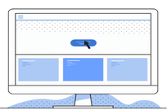
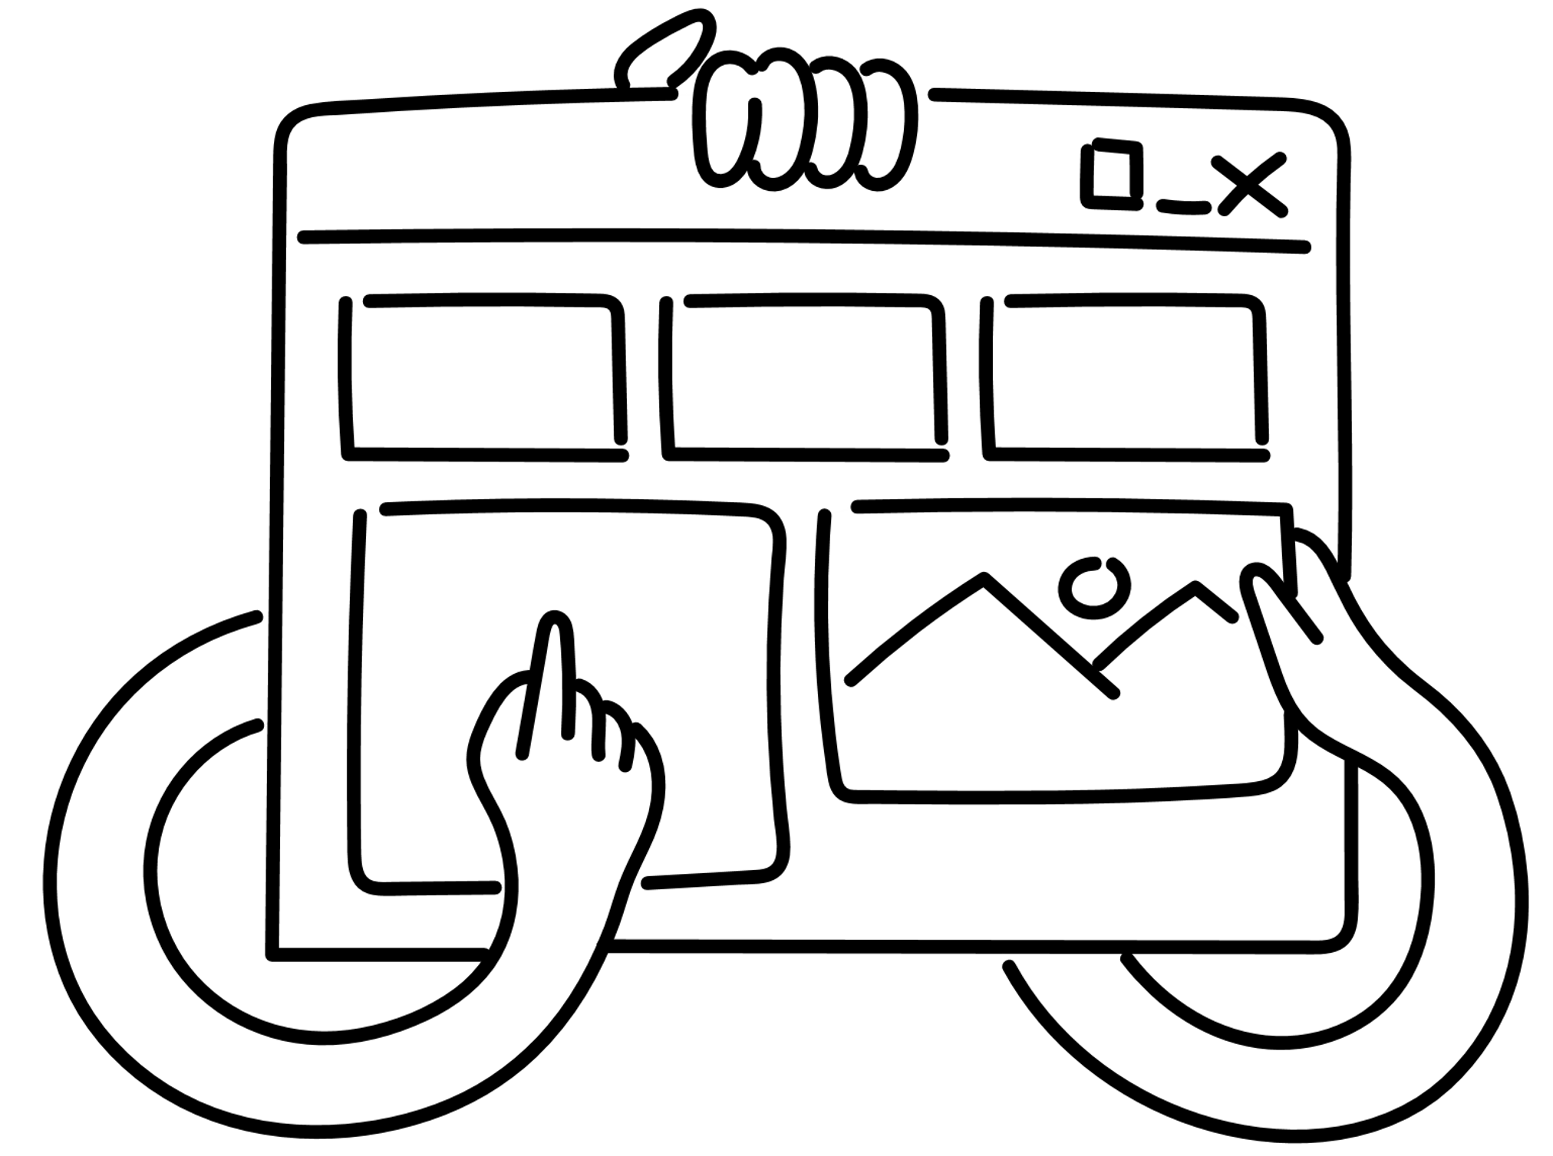




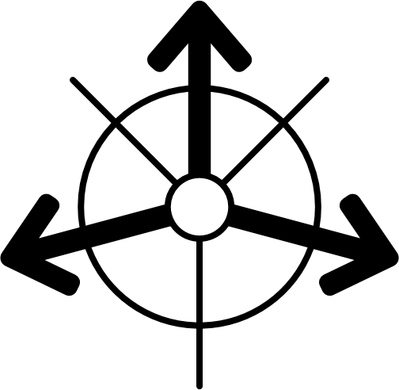



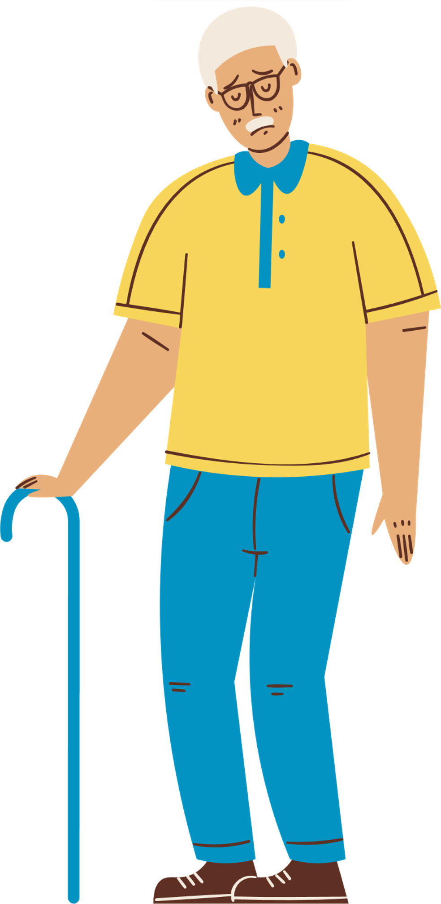
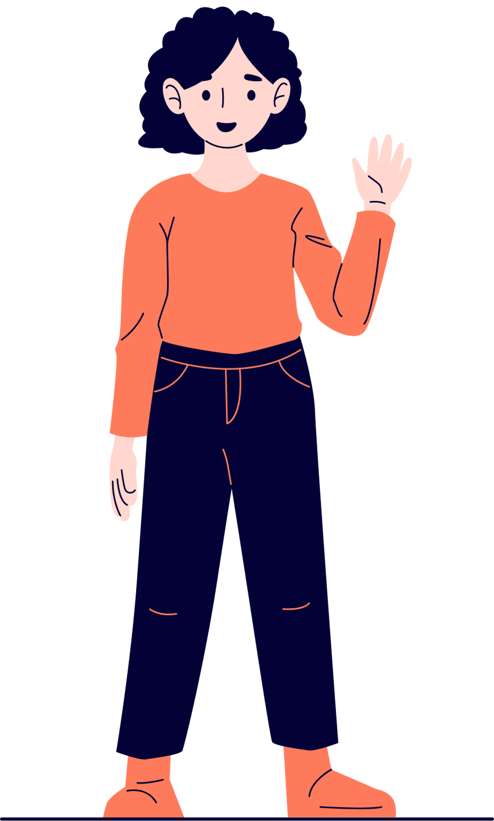


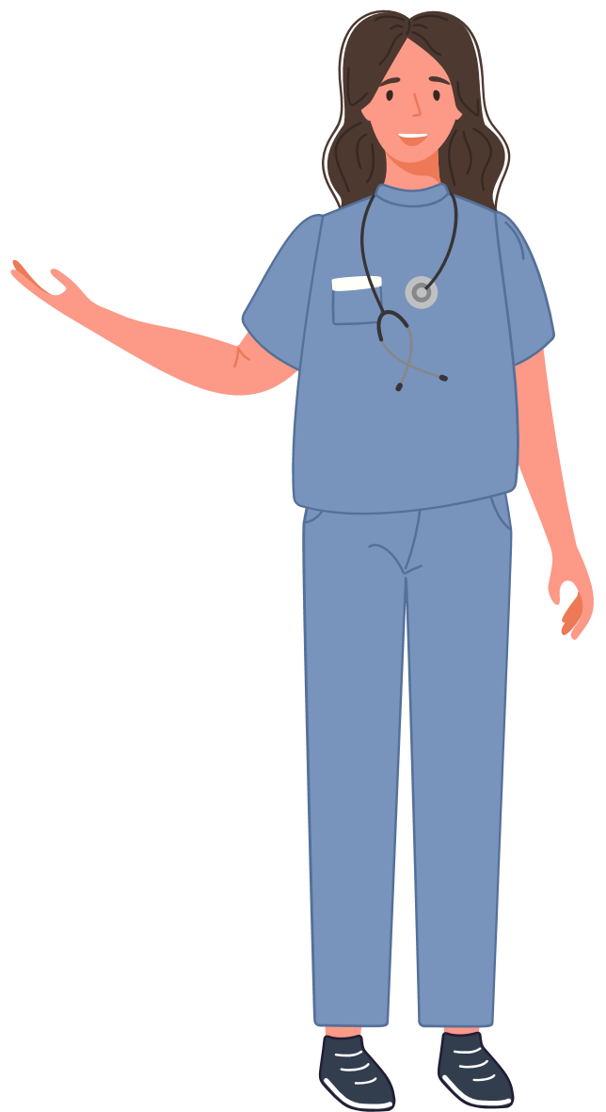


SOFTWARE DESIGN
Multimodal Advantage
Fall detection triggered via Django based Interface
Combines camera, motion, and vitals to reduce false alerts.
UI
Model Components
Login
Camera Page
Dashboard
Weekly Report
Core Models
Core Modules
Camera Based Model
Database
Camera, motion, and vitals fused to detect fall status.
Movement based Model
Predictions and vitals sent to backend through Django REST AP
Monitored through sensors; receives care via alerts and tracking
Rest API
Uses dashboard to monitor
Accesses weekly reports for patient evaluation.
Hear rate and SpO2 based Model
UI & Monitoring
Live feed, real-time graphs, weekly report for patient tracking.
Merged Model
Health care worker
OOAD Structure
Backend Developer
Modular Django classes enable scalability and easy device integration.
Elderly person/ Patient
Family member/ care taker
Data Scientist/ ML Engineer

Slide 8
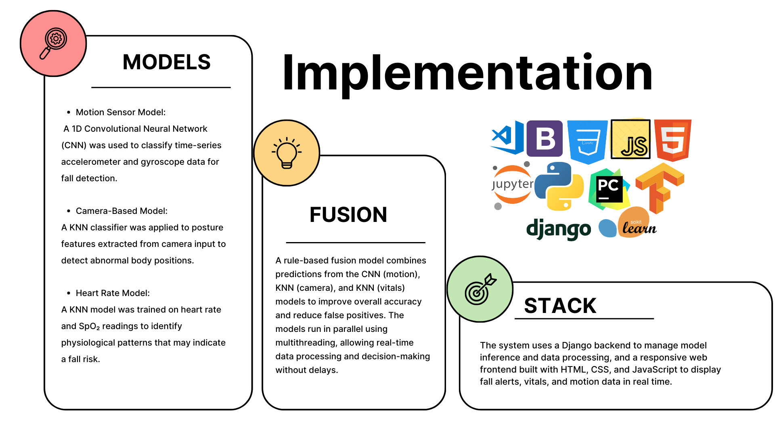

Slide 9
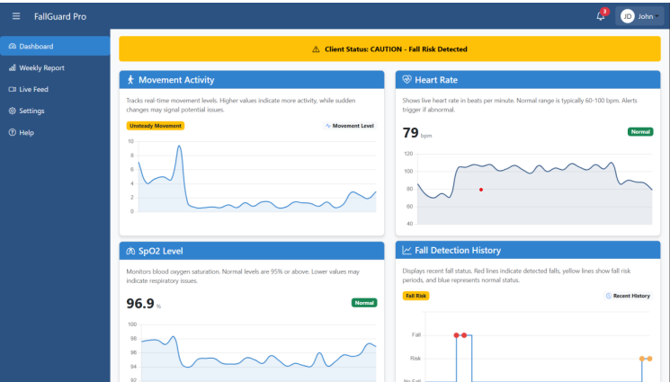
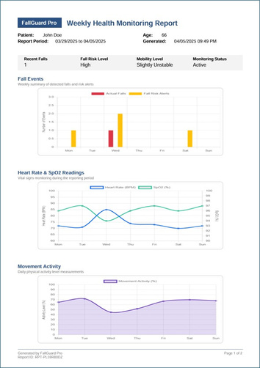
SOFTWARE DEMONSTRATION
Dashboard
Demonstration Video
Weekly Report

Slide 10


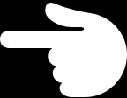

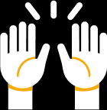
BUSINESS MODEL CANVAS
01 Key Partners
02 Key Activities
04 Value Proposition
05 Customer Relationship
07 Customer Segments
ML model development
Web platform integration
Report generation
Direct access for caregivers
Support for medical staff
Alert system for family members
Hospitals & clinics
Elder care facilities
IoT hardware suppliers
Elderly individuals
Patients with mobility issues
Family & healthcare providers
Real-time fall detection
Remote patient monitoring
Weekly health reports for doctors
03 Key Resources
06 Channels
ML models
Sensors (IoT)
Web platform (Django)
Web application
Healthcare partnerships
Add Notes or
Comments
Add Notes or
Comments
08 Cost Structure
09 Revenue Streams
Shapes
Development & maintenance
Sensor & hardware costs
Subscription plans
B2B hospital licensing

Slide 11
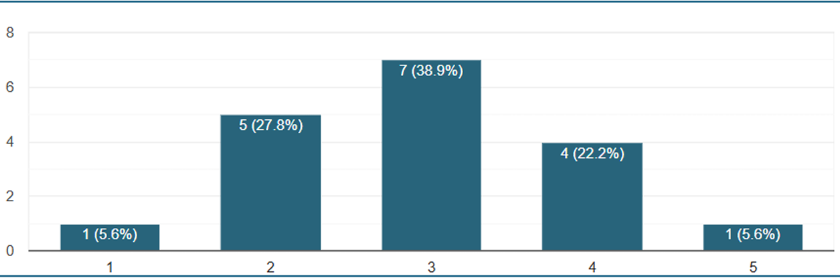
Testing and Evaluation
Model Summary
Response Summary
Evaluation Summary
Metrics | Joint Based Model | Movement Based Model | Heart Rate Based Model
Precision | 0.91 | 0.81 | 0.87
Recall | 0.88 | 0.93 | 0.88
F1-Score | 0.90 | 0.87 | 0.79
Accuracy | 0.88 | 0.90 | 0.89
Support Vectors | 786/1382 | 298/837 | -
Methodology:
Consulted technical and domain experts to critic and assess the application while handing out questionnaires to patients that have experienced fall-based injuries to assess their responses to the app
Criteria:
Scope
Target Audience Relevant
Real Worl Applicability
Concept
Detection Logic Soundness
Use of appropriate algorithms and tech
Goals
Safety and independence enhancement
Design
Accessibility (vision, mobility)
Ease of navigation and readability
Prototype
Fall detection accuracy
System responsiveness
Alert mechanism effectiveness
Method:
Provided digital questionnaire for each patient and was distributed by the physiotherapist at her clinic (domain expert), time taken to answer full questionnaire varied between 5~10 minutes
Conclusion:
Responses mostly range from 2 to 4, indicating a moderate sense of unsteadiness in isolated conditions

Slide 12




Limitations and Future Enhancements
Limitations No Multi-language Support The interface currently supports only one language. Moderate Model Accuracy Current models may not ensure precise fall risk prediction. Camera Angle Sensitivity Accuracy drops significantly with poor camera positioning. Limited Stress Context System doesn’t factor in emotional, psychological, or lifestyle data when assessing fall risk. | Future Enhancements Multi-language Interface Add support for Sinhala, Tamil, and other regional languages. Advanced AI Models Incorporate deep learning to boost prediction accuracy. Camera Angle Adaptation Train models to adapt to varied angles and lighting conditions. Holistic Stress Profiling Integrate emotional & behavioral data with vitals for smarter risk assessment.

Slide 13

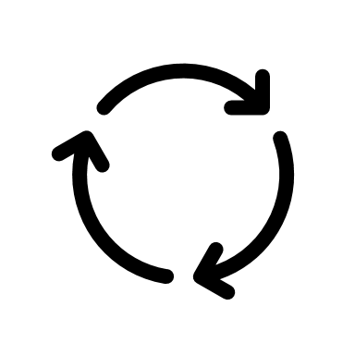
Conclusion
New Skills Acquired
Django framework Real-time data handling
Deployment of ML models into web apps Backend development
Use Of existing Skills
Programming Machine Learning Version Control
Web development Data visualization
Problems & Challenges Faced
Imbalanced fall risk classes Unreliable camera angles and lighting
Difficulty mapping vitals to meaningful risk levels
Publications
Research Paper Type Full conference paper Topic Fall Detection for Elderly Individuals Submitted To !!!!!!!!!!!!!!!! Status

Slide 14
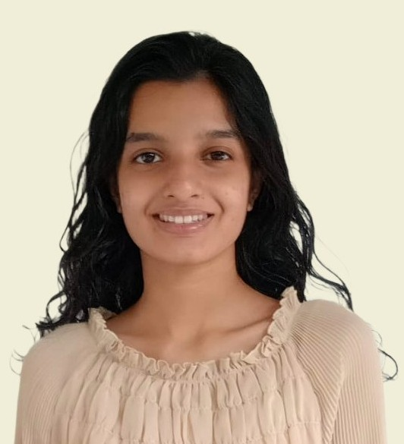
Individual Contributions
Ethan Perera
Team Leader
Senuli Wickramage
Himansa Jayasuriya
Mevinu Gunaratne
Literature Review
Developed Computer Vision/Occlusion Model
Responsible for pre-processing and assessing datasets for the computer vision model
Developed webpage and app for computer vision model on Django
Developed initial framework for Django project
Documentation
Literature Review
Developed the Accelerometer, Gyroscope sensor Data model
Developed the webpage for Weekly Report
Created the weekly report document
Worked on the simulation of sensor data
Real time data visualization in the Dashboard
Documentation
Conducted Literature Review
Developed the Fusion Model
Integrated three models to run in parallel in real time
Implemented logging system with time-stamped fall statuses
Created the Business Model Canvas
Focused on UI logic and alert button for Dashboard status display
Literature Review
Developed the Heart rate & SPO2 model
Designed the fall risk prediction logic based on vitals
Developed the webpage for the Login page
Contributed to report writing and final presentation
Handled model selection and performance tuning

Slide 15

Q&A

